Slide 1
Drama in the L2⁺ Classroom
Breathe Life into
Your Lessons

Slide 2
Objectives
To present strategies for incorporating drama into the L2 classroom.
To distinguish between Drama and Theatre.
To explore the benefits of drama in the classroom.
To workshop ways to teach a language through drama.
To empower teachers to defend the incorporation of drama into their curriculum.

Slide 3
WARMUP
“Birthday Order”
NO Talking!

Slide 4
WARMUP
Reflection
How did you do that?
Did you have to communicate to complete that activity?
What kind of communication did you use?

Slide 5
What is Communication?

Slide 6
What is Communication?
Brainstorm
with a partner

Slide 7
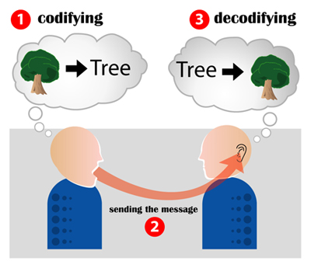
What is Communication?
“Communication is the activity of conveying information through speech, visuals, signals, writing, or behavior.”
Wikipedia

Slide 8
What is Communication?
“[Communication] may be intentional or unintentional, may involve conventional or unconventional signals, may take linguistic or non-linguistic forms, and may occur through spoken or other modes.”
National Joint Committee for the Communicative Needs of Persons with Severe Disabilities. [1992]

Slide 9
Extension
Activity
“Human Knot”
No talking
Anything but English
“over, under, through”

Slide 10
Extension
Activity
Reflection
Difficult? Easy?
What problems did you have?
Did you need more language to communicate?
Notes:
DRAMA ACTIVATES THE WHOLE STUDENT. Drama allows students to use all the resources for communication that they have at there disposal and broadens the definition of communication. Equals the playing field, so to speak. When learning a second language, we cannot it from pragmatic or social/cultural knowledge.

Slide 11
What is Drama?
Brainstorm
with a partner

Slide 12
History of Drama in the Classroom
“Appropriacy of Language”
1978 Maley & Duff
Brought Drama into the Second Language Classroom
1976 Richard Via
Democracy in Education
1968 Douglas Barnes
1981 Susan Holden
Product over Process
Process over Product
Fills gap between traditional language education and pragmatic needs of the students
Sociolinguistic approach to language learning
British tradition of theatre, little to do with authentic communication

Slide 13
What is Drama?
Drama
vs.
Theatre

Slide 14
Drama vs. Theatre
Interaction between two or more people that conveys meaning.
Process rather than product that is the focus of drama.
(Holden 1981, Via 1987, Zafeiriadou 2009)
Interaction between people for the benefit of an audience.
Must convey meaning among the performers and between the performers and the audience.
(Holden 1981; Via 1978, 1987)
Notes:
Ok, so how do they manifest in the classroom?

Slide 15
Dramatic Activities
Strategies to achieve
either drama or theatre.
[Richard Via 1987]
They are dramatic because they draw on the unpredictable power generated when one person is brought together with others. Each student brings a different life, a different background into the class.
[Haley & Duff 1978, 2011]
Notes:
Ok, so how do they manifest in the classroom?

Slide 16
Dramatic Activities
Simulation
Role-playing
Hot-seating
Teacher-in-role
Improvisation
Role-reversal
Thought-tracking
Mime
Living Pictures
Reader's theatre
Physicalizing Pronunciation
Debate
Alternative Ending
Notes:
Ok, so how do they manifest in the classroom?

Slide 17
Simulation
Simulations are dramatic, communicative activities that ask students to solve a problem as themselves.
[Livingstone 1983, Via 1987]
(task-based language teaching)

Slide 18
Activity
Situation: YOU ARE STRANDED ON A DESERTED ISLAND.
By yourself, make a list of 5 items you would want to have with you. (Ex. Matches, fishing string, etc)
Simulation

Slide 19
Activity
Situation: YOU ARE STRANDED ON A DESERTED ISLAND.
By yourself, make a list of 5 items you would want to have with you. (Ex. Matches, fishing string, etc)
Form small groups.
As a group, you can only keep 3 items total. Decide which 3 items you want to keep on the island.
Choose a leader and prepare to present which 3 items your group will keep and why.
Simulation

Slide 20
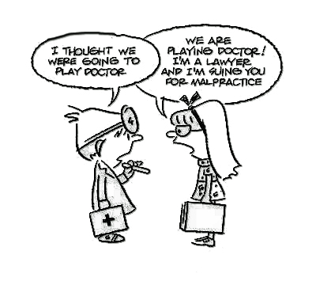
Role-playing
An extension of simulation where students are asked to take on different personas other than themselves with motivations and attitudes matching those new personas.
[Livingstone 1983]

Slide 21
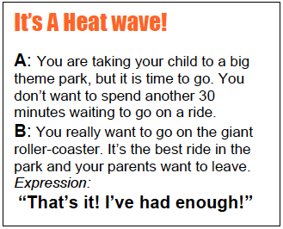
Activity
In groups, take a role-playing card. It will tell you about your character and your motivation.
Read your card and decide who will be A and who will be B.
Role-playing

Slide 22
Activity
In groups, take a role-playing card. It will tell you about your character and your motivation.
Read your card and decide who will be A and who will be B.
After talking about the situation and your characters, plan a short scene to present to the class.
Be sure to use the target language that’s on the card.
Role-playing

Slide 23
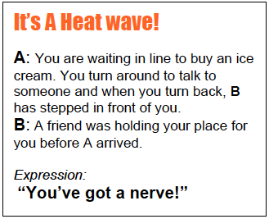
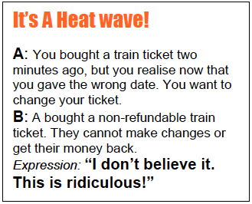
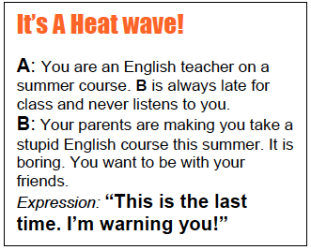
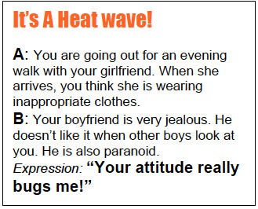
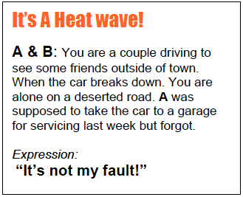
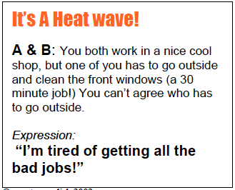
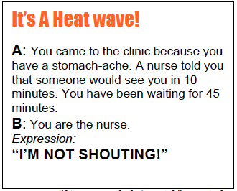
[Hidden Slide]
Reproducible Role-playing cards for activity.

Slide 24
Hot-seating
Interviewing a student who is ‘in role.’ Group and teacher can ask questions. This may be done by freezing the improvised action and removing the characters, or by sitting them formally on the 'hot-seat' to face questioners.

Slide 25
Dramatic Activities
Simulation
Role-playing
Hot-seating
Teacher-in-role
Improvisation
Role-reversal
Thought-tracking
Mime
Living Pictures
Reader's theatre
Physicalizing Pronunciation
Debate
Alternate Ending
Notes:
Ok, so how do they manifest in the classroom?

Slide 26
Dramatic Activities
Scriptwriting
Making a movie
Puppet show
Speeches/Monologues
Skits/Full Production
Product-based
Notes:
Ok, so how do they manifest in the classroom?

Slide 27
WORKSHOP
In groups…
Choose one dramatic activity.
Brainstorm how you could use that activity to teach a discreet skill or objective in a Listening or Speaking class.
Be prepared to present your ideas to the class.

Slide 28
Defending Drama in the Classroom
Excite
Engage
Empower

Slide 29
Benefits of Drama in the Classroom
DEFENDING DRAMA
[Haley & Duff 1978, 2011]
Integrates language skills in a natural way: Careful listening is key and spontaneous verbal expression is integral. Reading and writing can also be involved as a part of the input and output.
Integrates verbal and non-verbal aspects of communication. [physical and intellectual]
Integrates cognitive and affective domains. [feeling and thinking]
Contextualizes language through a focus on meaning.
Holistic, presents opportunities for catering to learner differences.
Fosters self-awareness (and awareness of others), self esteem and confidence.

Slide 30
Benefits of Drama in the Classroom
DEFENDING DRAMA
[Haley & Duff 1978, 2011]
Motivation is fostered and sustained through the variety and drama’s unpredictable nature.
Transfer of responsibility for learning from teacher to learners.
Encourages an open and exploratory environment where creativity and imagination can develop. This also promotes risk-taking which is essential in language learning.
Positive effect on classroom dynamics and atmosphere.
Low resource. For the most part, all you need is a “roomful of human beings.”

Slide 31
Beyond Method
DEFENDING DRAMA
10 Macrostrategies for Teachers
[Kumaravadivelu 1994]
Maximize learning opportunities
Facilitate negotiated interaction
Minimize perceptual mismatches
Activate intuitive heuristics
Foster language awareness
Contextualize linguistic input
Integrate language skills
Promote learner autonomy
Raise cultural consciousness
Ensure social relevance

Slide 32
Communicative Language Teaching
DEFENDING DRAMA
[Spada 2007]
Communicative language teaching is “a meaning-based, learner-centered approach to L2 teaching where fluency is given priority over accuracy and the emphasis is on the comprehension and production of messages, not the teaching or correction of language form.”

Slide 33
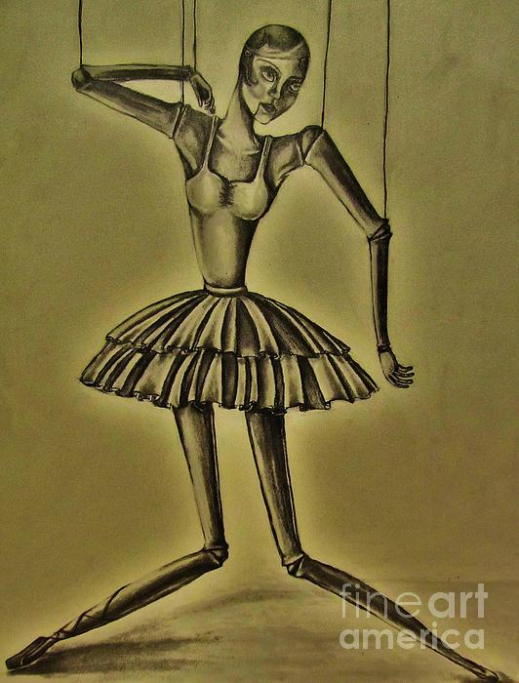
In Conclusion . . .
Drama is a transformative, human-making activity, with the potential to affect our personalities, adjust our codes of behavior, and mold our autonomy as individuals.
[Zafeiriadou, 2009; Via, 1978; Hismanoglu,
2005; Livingstone, 1983; Barnes, 1968]

Slide 34
In Conclusion . . .
Drama gives students a virtual experience in functioning in extended, realistic discourse in the target language where learners are able to learn not only appropriate language use, but real communicative processes as well.
Drama provides learners with opportunities to interact directly with target language and to acquire it by using it.
“Tell me and I forget, teach me and I
may remember, involve me and I learn.”

Slide 35
Everyone Loves
a Good Metaphor
Language teachers sometimes behave like the owners of large estates, putting up high walls round their territory and signs saying ‘No Trespassing.’ Drama is like the naughty child who climbs the high walls and ignores the ‘No Trespassing’ sign. It does not allow us to define our territory so exclusively—it forces us to take as our starting point life not language. [It] may involve music, history, paining, mathematics, skiing, photography, cooking—anything. It does not respect subject barriers.
The language teacher will be wise to take advantage of this to enliven their work. Once his students have discovered that there is another world, much closer and more real that that of the [the textbook], the problem of ‘how to keep their interest’ will gradually disappear. And, strangest of all, this other world does not need to be conjured up with expensive equipment—all that is needed is a roomful of human beings.
[Maley & Duff 1980]

Slide 36
Barnes, D. (1968). Drama in the English classroom. Champaign, IL: National Council of Teachers of English.
Holden, S. (1981). Drama in language teaching: Longman handbook for language teachers. London, Great Britain: Spottiswoode Ballantyne Ltd.
Kumaravadivelu, B. (1994). The postmethod condition: (E)merging strategies for second/foreign language teaching. TESOL Quarterly, 28(1), 27-48.
Livingstone, C. (1983). Role-play in language learning: Longman handbooks for language teachers. Singapore: The Print House Ltd.
Maley, A., & Duff, A. (1978, 2011). Drama techniques: A resource book of communication activities for language teachers (3rd Edition). In P. Ur (Series Ed.), Cambridge Handbooks for Language Teachers, Cambridge: CUP.
Spada, N. (2007). Communicative language teaching: Current status and future prospects. In J. Cummins & C. Davison (Eds.), International handbook of English language teaching (pp. 271-288). New York: Springer.
Stanislavski, C. (1936). An actor prepares. New York: Theatre Arts Books.
Via, R. A. (1976). English in three acts. HongKong: The University Press of Hawaii.
Via, R. A. (1987). “The magic if” of theater: Enhancing language learning through drama. In W. M. Rivers (Ed.), Interactive Language Teaching (pp. 110-123). Cambridge: Cambridge University Press.
References

Slide 37
Bolton, G. (1992). New perspectives on classroom drama. Great Britain: Simon & Schuster.
Boal, A. (1993). Theatre of the oppressed, New York: Theatre Communications Group.
Burke, A. & O’Sullivan, J. C. (2002). Stage by stage: A handbook for using drama in the second language classroom, New York: Heinemann Drama.
Janudom, R. & Wasanasomsithi, P. (2009). Drama and questioning techniques: Powerful tools for the enhancement of students’ speaking abilities and positive attitudes towards EFL learning. ESP World, 8(5), 1-19. Retrieved from http://esp-world.info/index.htmlRyan-Scheutz, C. and Colangelo, L. M. (2004). Full-Scale Theater Production and Foreign Language Learning. Foreign Language Annals, 37(3), 374–385.
Jones, K. (1982). Simulations in language teaching, Cambridge: CUP.
Kaplan, S. (Ed.). (2011). Teaching drama in the classroom, Boston: Sense.
Malkoc, A. M. (1993). Easy plays in English, Englewood Cliffs, NJ: Prentice Hall.
Rathburn, A. K. (2000). Taking centerstage: Drama in America. In S. M. Gass & A. L. Tickle (Series Eds.), The Michigan State University textbook series of theme-based content instruction for ESL/EFL, Ann Arbor: U of Michigan P.
Watcyn-Jones, P. (1988). Act English, New York: Penguin Books.
Whiteson, V. (1996). New ways of using drama and literature in language teaching. In J. C. Richards (Series Ed.), New ways in TESOL series II: Innovative classroom techniques, Bloomington, IL: TESOL, Inc.
Whiteson, V., & Horovitz, N. (2002). The play’s the thing: A whole language approach to learning English. Cambridge, England: Cambridge University Press.
Winston, J. (Ed.). (2012). Second language learning through drama: Practical techniques and applications, London: Routledge.
Other Resources

Slide 38
Drama in the L2⁺ Classroom
www.matthewbarbee.com/english-through-drama.html
University of Hawaii
Department of Second Language Studies

