Slide 1


Needs Analysis and Genre Analysis in Developing Student Centered ESP Curriculum
www.matthewbarbee.com
matthewkamden@gmail.com
Matthew Barbee
University of Hawaii at Manoa

Slide 2
Presentation Overview
Program Development
  What We Knew: Literature Review
  What We Wanted to Know: Needs Analysis
  What We Learned: Results
  What We Produced: Syllabus and Objectives
Genre Analysis
  Lesson Plan and Materials
  Advantages of Genre Analysis
Questions

Slide 3

Program Development
Last year…
to investigate the situational and linguistic needs of a new English program for adult learners at a homeless shelter serving a Micronesian migrant population in Hawaii.
to develop a language program informed by those findings.
[Barbee, Escalona, Holdway, 2012]

Slide 4
• Micronesian Immigrants in Hawaii
• Adult Learners of English
• English for Specific Purposes (ESP)
What We Knew

Slide 5
The realities of the
U.S. migrant population.
Reason for migration:
✓ improved health care
✓ education
✓ employment opportunities
Difficulties after arrival:
✗ inability to find work
✗ inability to find housing
✗ inability to communicate in English
[Migrant Policy Institute 2009]
Notes:
In 2009, the foreign-born population represented 17.3 percent of Hawaii’s total, of which 6.3 percent are migrants having arrived in Hawaii during the last three decades (Migrant Policy Institute, 2009).
The three main reasons for migration are improved health care, education, and employment opportunities; however, after arrival there is often the inability to find work, the most prevalent reason being English language challenges.
As a result, there is a high number of migrants in Honolulu’s homeless shelters in need of language education focused on ESP.

Slide 6


Micronesians in Hawaii
Compact of Free Association (19986)
[Photography by Elyse Butler and Matt Mallams, From the article, Micronesians in Hawaii (2010) by Michael Keany]
[Grieco 2003, Pobutsky et al. 2005, Omori et al. 2007, Hezel & Samuel 2006, “Status of Micronesian Migrants” 2003]
Notes:
This immigrant situation was heightened in 1986 by the creation of the Compact of Free Association (COFA). Under this agreement, residents of the Federated States of Micronesia (FSM) – composed of Chuuk, Kosrae, Pohnpei and Yap – and the Republic of the Marshall Islands (RMI) (among other Pacific Island nations) became eligible to enter the United States, its territories, and commonwealths without a visa or time limit (Grieco, 2003); in fact, individuals from the FSM are the fastest-growing community of Micronesians in Hawaii (U.S. Census Bureau, 2010).
While the Compact provided the FSM with economic development aid and provisions for increased health care, they were poorly funded, in particular with health and education, leaving the FSM and RMI lacking self-sufficiency; more specifically, this is partly because “strategies and resources to develop local leadership and management capacities were not included in the settlements” (Pobutsky, Buenconsejo-Lum, Chow, Palafox, & Maskarinec, 2005, p. 61). The countries’ limited economic resources and struggling education and health care systems are significant factors in these residents choosing to leave (Omori, Kleinschmidt, Lee, Linshield, Kuribayashi, & Lee, 2007; Pobutsky et al., 2005). After arrival, however, there is often significant difficulty in finding employment, particularly due to low-level English skills. As an unfortunate result, there are a disproportionate number of families of Micronesian descent in Honolulu’s homeless shelters and who would benefit from ESL education within the shelters themselves (Hezel & Samuel, 2006; “Status of Micronesian Migrants,” 2003; personal communication, January 23, 2012).

Slide 7
Adult Learners of English
What challenges do adult learners of English face?
Logistical challenges
Program availability challenges
Language barriers
Employment
Housing
Medical issues
[National Center for Education Statistics 1995]

Slide 8
Adult Learners of English
Why do adult learners of English choose to participate in education programs?
Communicate in their everyday lives
Get a job or pursue better employment
Become a citizen of the United States
Get a high school diploma or GED certificate
Help their children succeed
[National Center for Education Statistics 1995, Skilton-Sylvester & Carlo 1998,
Teachers of English to Speakers of Other Languages 2003]

Slide 9
English for Specific Purposes (ESP)
ESP is an approach to language teaching in which all decisions as to content and method are based on the learner’s purposes for learning.
English for Survival Skills
  Using English to live and reside in an English speaking country (e.g. shopping, housing, etc.)
  Using English for work-related skills (e.g. reading a “help wanted” ad, reading a paycheck, etc.)
[Belcher 2006, Frye 1999, Hutchinson & Walters 1990, Hyon 1996]

Slide 10
What We Want to Know
Needs Analysis
“The systematic collection and analysis of all subjective and objective information necessary to define and validate defensible curriculum purposes that satisfy the language learning requirements of students within the context of particular institutions that influence the learning and teaching situation.”
J. D. Brown (1995, 2001)
Notes:
According to Brown (1995, p. 36), the three basic steps of needs analysis are:
1. Making basic decisions about the needs analysis
2. Gathering information
3. Using the information

Slide 11
Needs Analysis: Methodology
•Who will be involved?
•What information will be collected?
•What points of view will be represented?
J. D. Brown (1995, 2001)

Slide 12
Who will be involved?
S T A K E H O L D E R S
Target group: Students (clients of the center)
Audience: Teachers, shelter staff
Needs Analysts: Three researchers
Resource group: Teachers, center staff

Slide 13
What information will be gathered?
I N S T R U M E N T S
Literature review
Existing records/reports
Informal meetings with staff
Staff and teacher questionnaire:
    Situational inventory
    Learner inventory
Observations
Student questionnaires
Student-written narratives

Slide 14
What points of view will be represented?
situational needs
vs. linguistic needs
objective needs
vs. subjective needs
[Brown 1995]

Slide 15
Why are so many instruments and perspectives necessary?
[Taken from Barbee, Escalona, Holdway, 2012]

Slide 16
Needs Analysis: Procedure
Before Interaction
Existing Information:
Learner Needs Inventory:
During Instruction
Formative Student Evaluation:
Socio-political factors
Student demographics
Shelter setting
Classroom setting
Instruments:
Literature review
Existing records/reports
Informal meetings with staff
Staff and teacher questionnaire
Initial Interaction
Students’ educational and linguistic needs
Specific purposes for which English will be used
Instruments:
Observations
Student Questionnaire
Personal Narratives
Student work
Student motivation and attitudes
Situational restraints to student attention
Interaction with students and teachers and staff
Instruments:
Observations
Observations

Slide 17
What We Learned [Rationale for Curriculum Content]
[Barbee, Escalona, Holdway, 2012]

Slide 18
Functional & Situational Syllabus
Greetings and Introductions
Forms and Documents
Personal Information
Directions
Events and Scheduling
Shopping
Phone Calls
Jobs
Job Interviews
Medical Needs
Computer Literacy Skills
Setting up an Email Account
[Barbee, Escalona, Holdway, 2012]

Slide 19
Learning Objectives: Finding a Job
[Barbee, Escalona, Holdway, 2012]

Slide 20
What We Learned [Rationale for Curriculum Methodology]
[Barbee, Escalona, Holdway, 2012]

Slide 21
Genre Analysis as Methodology
A genre is a class of discourse, the members of which share communicative purposes. These purposes are recognized by the members of the parent discourse community. These purposes shape the structure of the discourse and influences content and style.
(Swales, 1990)

Slide 22
Genre Analysis as Methodology
  Genre Analysis is an investigative procedure that analyzes the connections between a certain genre and its communicative purpose. (Huttner et al. 2009)
  Connection between the use of language
  and purpose for which we use it.
  Language does not exist in a vacuum.
Notes:
Language doesn’t exist in a vacuum. It cannot be separated from context and exists to fulfill a purpose. All examples of a certain genre have a common communicative purpose.

Slide 23
Genre Analysis as Methodology
  Genre Analysis allows students to be able to place a certain genre within the context of its language community, investigate it, and create new examples within that genre.
  What purpose does it serve?
  What is the macrostructure?
  What is the microstructure?
  How does the structure work to achieve the communicative purpose of the genre?
  How does this genre compare to other genres?
Past proponents of Genre Analysis have focused on academic and business models of genre.
  (adapted from Huttner et al. 2009, Swales 1990)
Notes:
Language doesn’t exist in a vacuum. It cannot be separated from context and exists to fulfill a purpose. All examples of a certain genre have a common communicative purpose. Genre Analysis allows teachers and students to be able to place a certain genre within the context of its certain language community and ask what purpose does it serve. What is the common structure, what is the microstructure, how does the structure work to achieve the communicative purpose of the genre? How does this genre compare to other genres?

Slide 24

Job Applications
Lesson
“Life Skills” English
Class
90 minutes
Duration
ESP program for adult migrant population in downtown Honolulu. Beginning to low-intermediate learners.
Context
Lesson Plan
Learning Objectives
The Students Will:
Identify common features of job applications.
Fill-out a job application form using personal information.
Use strategies, i.e., dictionary, context clues, etc., to determine the meanings of unknown vocabulary

Slide 25
Warm up:
Personal Information Form Wall Race
Vocabulary Review:
Card Slapping Activity
Introduction to New Content:
Job Application Genre Analysis
Skills/Content in Context:
Identify specific information from a sample job application
Synthesis/Production:
Complete an actual job application
Lesson Plan
• Before class, the teacher will have prepared 7 pieces of paper with different bits of information about a fictional person. The teacher will tape these pieces of paper around the room.
• Students will make pairs. Teacher will give each pair a handout with a blank information form on it.
• Using the 7 sheets of paper around the room, the pair must work together to fill the information into the matching fields on the information form. The form can be required to remain at a central location so that students have to use their memories to fill-out the form.

Slide 26
Warm up:
Personal Information Form Wall Race
Vocabulary Review:
Card Slapping Activity
Introduction to New Content:
Job Application Genre Analysis
Skills/Content in Context:
Identify specific information from a sample job application
Synthesis/Production:
Complete an actual job application
Lesson Plan
• Before class, the teacher will have prepared sets of 12 cards each with a picture of a different job.
• The students will form groups of two or three. Teacher will give each group a set of the cards.
• Students will arrange the cards on their desk, facing up.
• While the teacher says the name of a job, the students must slap and take the card that matches that job name.
• The student with the most cards in their group when all the professions have been called wins.

Slide 27
Warm up:
Personal Information Form Wall Race
Vocabulary Review:
Card Slapping Activity
Introduction to New Content:
Job Application Genre Analysis
Skills/Content in Context:
Identify specific information from a sample job application
Synthesis/Production:
Complete an actual job application
Lesson Plan
Students make groups of three, while teacher passes out a set of 3 different sample job applications to each group.
Teacher will ask each group to look at the applications and compare them. Together, each will circle words or phrases or labels that are the same on all applications. Students will make a running list of these words.
Teacher will record some of the words from each group on the board, then the teacher will ask if students know the words. If students don’t know the words, they must record them in their vocabulary diaries so that they can be looked up later.
(4 – 5) →

Slide 28
Warm up:
Personal Information Form Wall Race
Vocabulary Review:
Card Slapping Activity
Introduction to New Content:
Job Application Genre Analysis
Skills/Content in Context:
Identify specific information from a sample job application
Synthesis/Production:
Complete an actual job application
Lesson Plan
With the list of common words on the board, the teacher will call on students to give their own information in relation to the word. For example, common words on a job application may include name, phone number, date of birth, Are you a citizen of the U.S.?, etc. Students will respond with this information and the teacher will write it on the board beside the corresponding word. This is repeated.
The above activity is repeated for the words that are not common to all the applications in each group. The students will draw boxes around these words, and a list will be made on the board again.
[Throughout this process, the teacher will use an inquiry-based approach.]

Slide 29
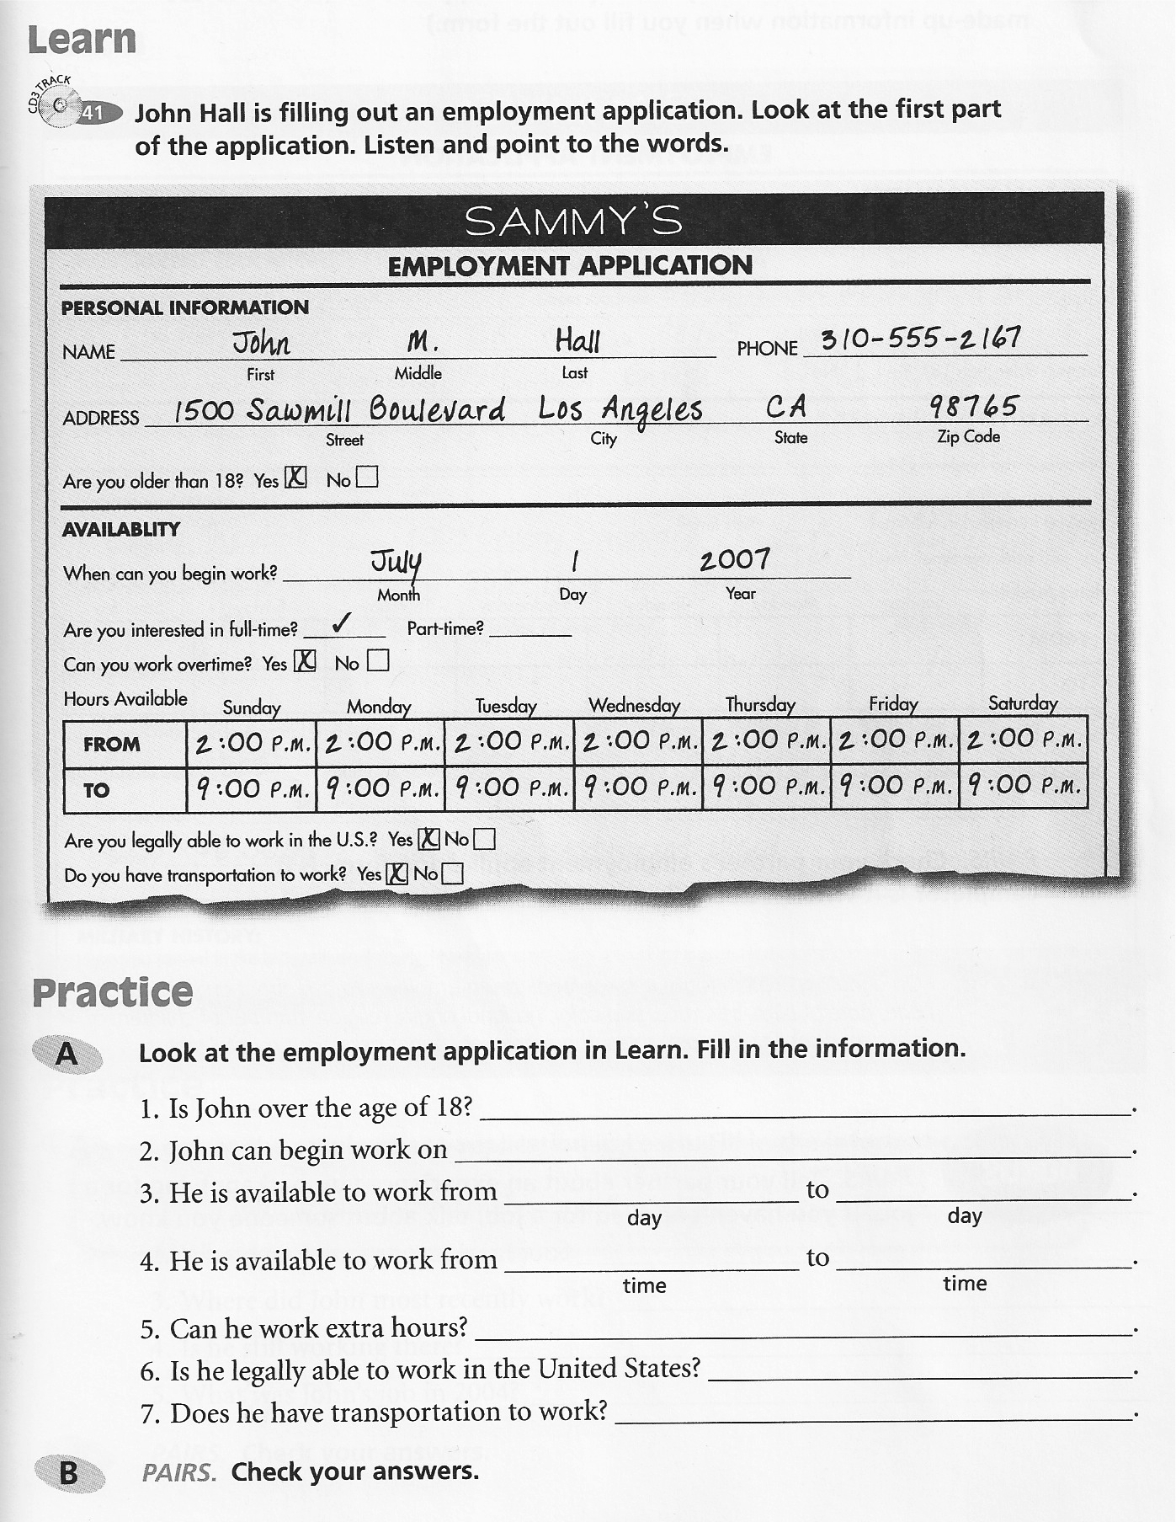
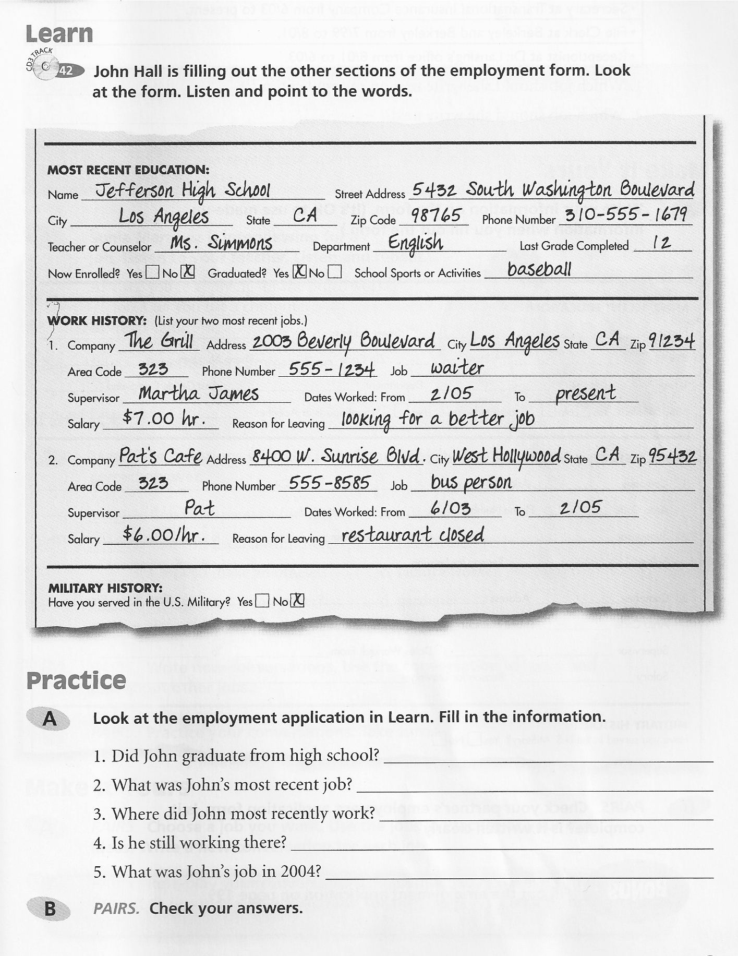
Warm up/Content Review:
Personal Information Form Wall Race
Vocabulary Review:
Card Slapping Activity
Introduction to New Content:
Job Application Genre Analysis
Skills/Content in Context:
Identify specific information from a sample job application
Synthesis/Production:
Complete an actual job application
Lesson Plan
Working from the textbook, Life Skills and Test Prep, p. 165 & 167) students will be presented with completed job applications and be asked to identify specific information from the application and answer questions using that information.

Slide 30
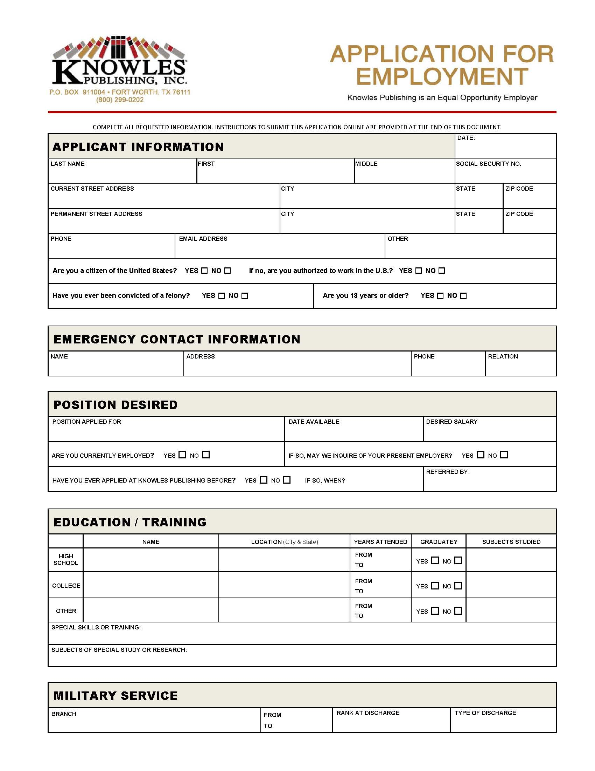
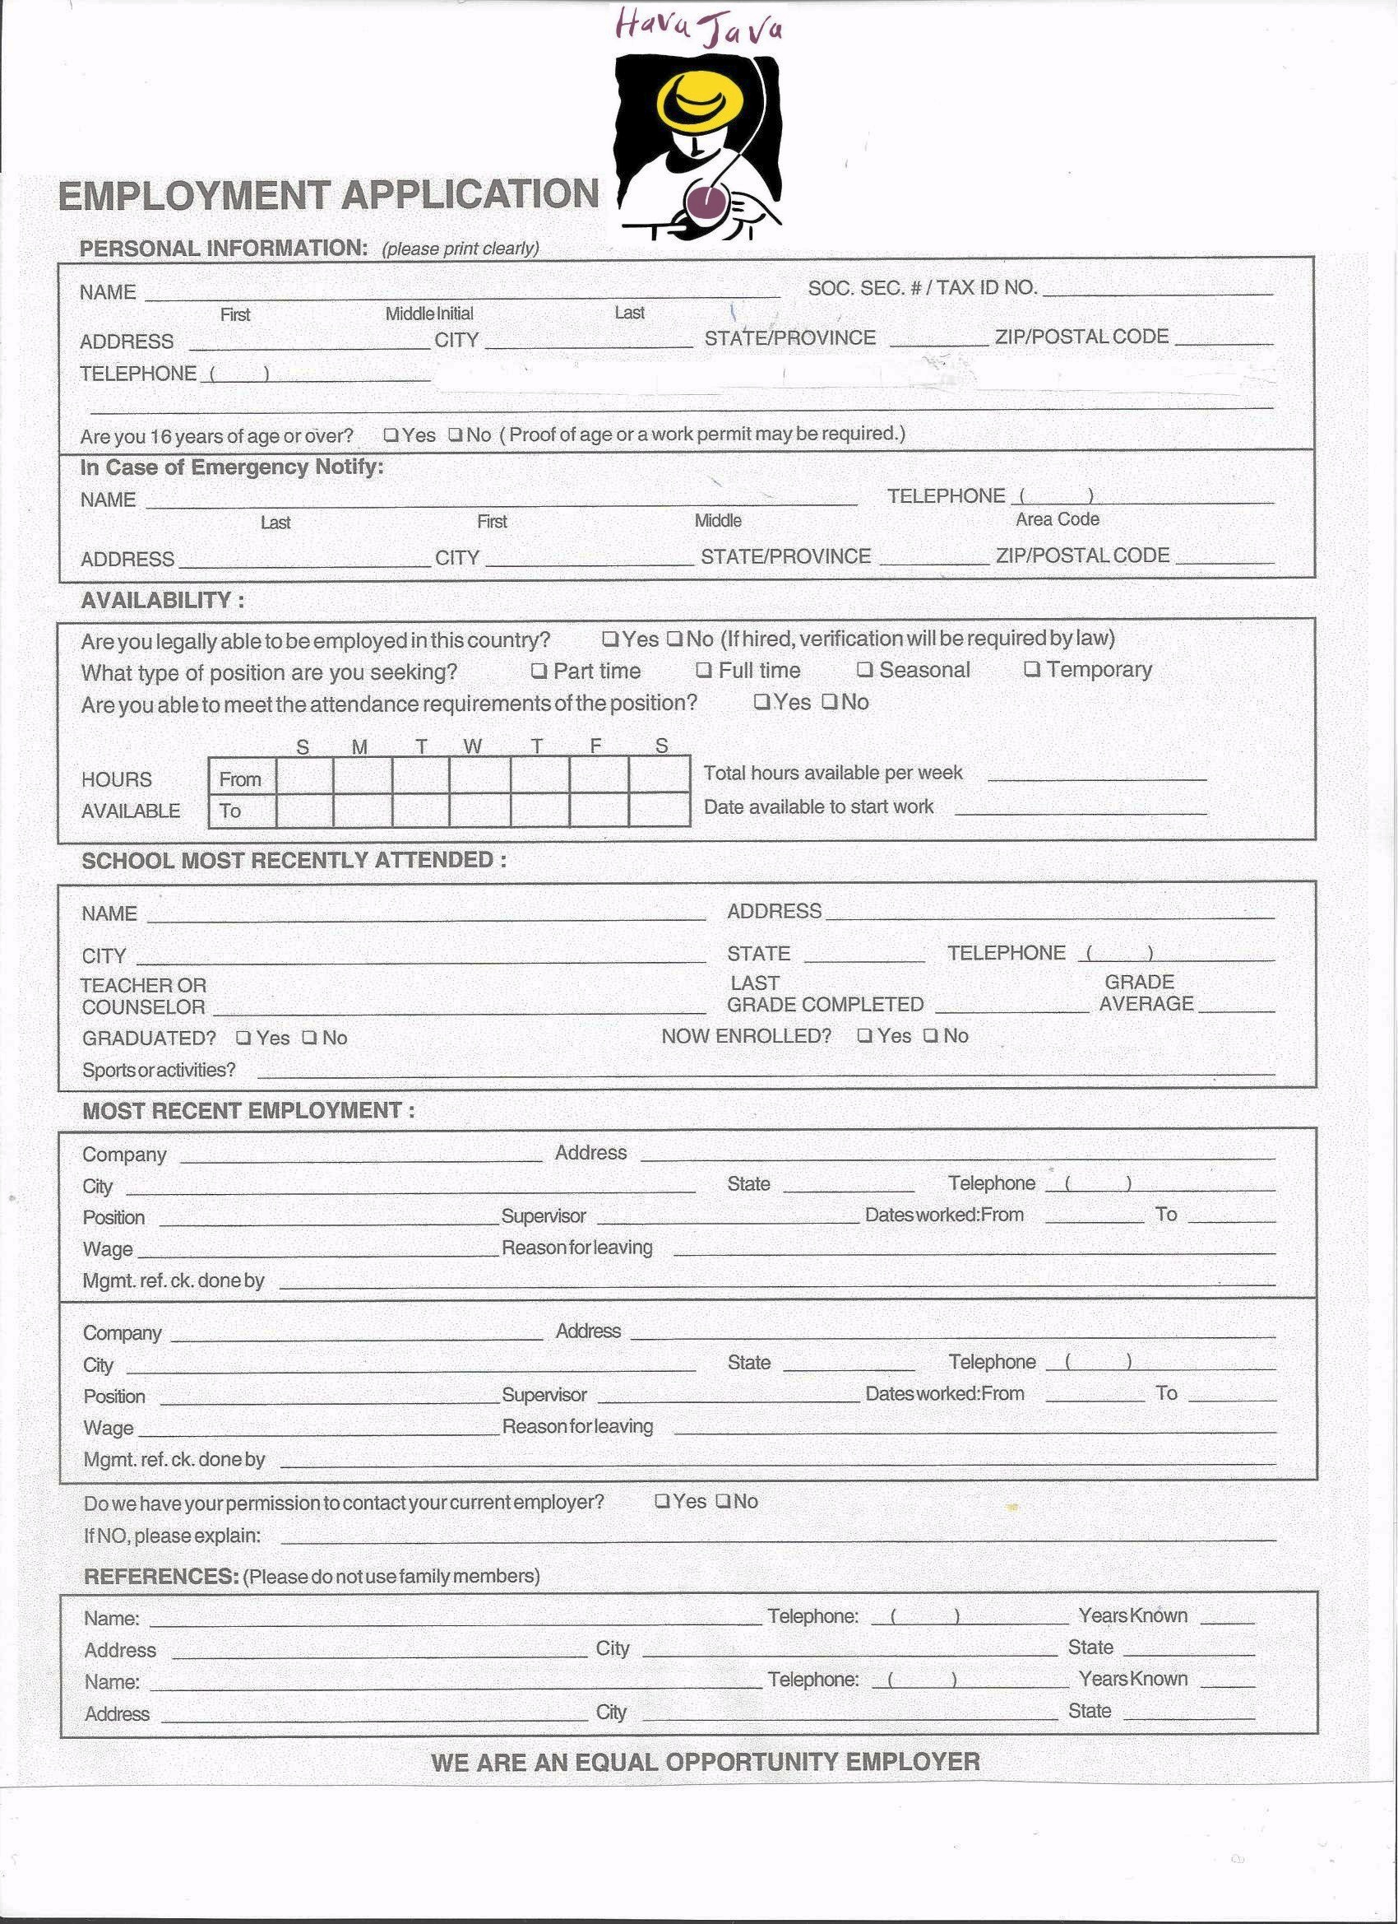
Warm up:
Personal Information Form Wall Race
Vocabulary Review:
Card Slapping Activity
Introduction to New Content:
Job Application Genre Analysis
Skills/Content in Context:
Identify specific information from a sample job application
Synthesis/Production:
Complete an actual job application
Lesson Plan
Students can bring in real job applications from popular companies in the area that they are interested in working at. Students can work together in groups to fill-out the applications with their own information.

Slide 31
Advantages of Genre Analysis
  Allows students access to a certain genre of writing or discourse so that they can make their own discoveries and connect language to its purpose.
  Allows students to meet language face-to-face rather than being “hit” with it. [own level]
  Teachers don’t have to ‘reinvent the wheel’ or be experts in every field.
  Student-centered classrooms lead to autonomy.

Slide 32
NEED FOR VOLUNTEERS!
The future of the ESP program at IHS is dependent on skilled volunteers, like you, to serve as teachers. Please contact me or IHS Hawaii for more information on how you can help.
www.ihshawaii.org

Slide 33

Selected References
Barbee, M., Escalona, J., & Holdway, J. (2012). Development of an ESP program for a Micronesian population in Hawaii. In H. Ahn & M. Vidal (Eds.) Proceedings 2012: Selected papers from the sixteenth college-wide conference for students in languages, linguistics, and literature (pp. 29-40). College of Languages, Linguistics, and Literature, University of Hawaii at Manoa.
Bhatia, V. K. (2008). Genre Analysis, ESP and professional practice. English for Specific Purposes, 27(2), 161-174.
Belcher, D. (2006). Teaching to Perceived Needs and Imagined Futures in Worlds, Study, and Everyday Life. TESOL Quarterly, 40(1), 133-156.
Frye, D. (1999). Participatory Education as a Critical Framework for an Immigrant Women’s ESL Class. TESOL Quarterly, 33(3), 501-513.
Huttner, J., Smit, U., & Mehlmauer-Larcher, B. (2009). ESP teacher education at the interface of theory and practice: Introducing a model of mediated corpus-based genre analysis. System, 37, 99-109.
Hyland, K. (2007). Genre Pedagogy: Language, literacy and L2 writing instruction. Journal of Second Language Writing, 16, 148-164.
Hyon, S. (1996). Genre in three traditions: Implications for ESL. TESOL Quarterly, 30(4), 693-722.
Magy, R., & Pomann, H. (2007). Life skills and test prep 2. White Plains, NY: Pearson Education.
Migrant Policy Institute. (2003). Migration facts, stats, and maps: Hawaii social and demographic characteristics. Retrieved from http://www.migrationinformation.org/datahub/state.cfm?ID=HI
Swales, J. M. (1990). Genre analysis: English in academic and research settings. Cambridge: Cambridge University Press.
PAO

Slide 34
Needs Analysis and Genre Analysis in Developing Student Centered ESP Curriculum
www.matthewbarbee.com
matthewkamden@gmail.com
Matthew Barbee
University of Hawaii Manoa
QUESTIONS

