Slide 1


From Needs Analysis to
Program Development
Matthew Barbee
Juan Escalona
Jennifer Holdway
University of Hawaii at Manoa
SLS630: Program Development
A New Adult ESP Program for
a Migrant
Micronesian Population
in Hawaii

Slide 2

The realities of the
U.S. migrant population.
Reason for migration:
✓ improved health care
✓ education
✓ employment opportunities
Difficulties after arrival:
✗ inability to find work
✗ inability to find housing
✗ inability to communicate in English
[Migrant Policy Institute 2009]
Notes:
In 2009, the foreign-born population represented 17.3 percent of Hawaii’s total, of which 6.3 percent are migrants having arrived in Hawaii during the last three decades (Migrant Policy Institute, 2009).
The three main reasons for migration are improved health care, education, and employment opportunities; however, after arrival there is often the inability to find work, the most prevalent reason being English language challenges.
As a result, there is a high number of migrants in Honolulu’s homeless shelters in need of language education focused on ESP.

Slide 3
Purpose of this study:
to investigate the situational and linguistic needs of a prospective English program to be offered to adult English language learners at a temporary homeless shelter serving a predominantly Micronesian migrant population in Hawaii.
to develop a language program at the above shelter with objectives, materials, and a teacher’s guide that are informed by those findings.

Slide 4
Presentation Overview
Literature Review
Needs Analysis
Methodology
Procedure
Results
Discussion of Needs Analysis
Program Development
  Objectives and Syllabus
  Materials
  Teacher’s Guide
Final Thoughts & Questions

Slide 5
• Micronesians in Hawaii
• Adult Learners of English
• English for Specific Purposes (ESP)
Literature Review

Slide 6


Micronesians in Hawaii
[Photography by Elyse Butler and Matt Mallams, From the article, Micronesians in Hawaii (2010) by Michael Keany]
[Pobutsky et al. 2005, Omori et al. 2007, Hezel & Samuel 2006, “Status of Micronesian Migrants” 2003]
Notes:
Photography by Elyse Butler and Matt Mallams
From the article, Micronesians in Hawaii (2010) by Michael Keany
----- Meeting Notes (4/19/12 14:16) -----
Compact of …
homeless? not all

Slide 7
Adult Learners of English
What challenges do adult learners of English face?
Logistical challenges
Program availability challenges
Employment
Housing
Language barriers
Medical issues
Psychological and social issues
[National Center for Education Statistics 1995]

Slide 8
Adult Learners of English
Why do adult learners of English choose to participate in education programs?
Communicate in their everyday lives
Get a job or pursue better employment
Become a citizen of the United States
Get a high school diploma or GED certificate
Advance to higher education programs
Help their children succeed in school
[National Center for Education Statistics 1995, Skilton-Sylvester & Carlo 1998,
Teachers of English to Speakers of Other Languages 2003]

Slide 9
English for Specific Purposes
ESP: Questions to Consider
How do we plan for an English program that focuses on survival skills?
What are the different social, pedagogical, and economic constraints that may affect our program?

Slide 10
English for Specific Purposes
English for Survival Skills
  Using English to reside in the U.S. (e.g. shopping, housing, etc.)
  Using English for work-related skills (e.g. reading a “help wanted” ad)
Theories of ESP
  Genre theory: Analyzing the environment as it is interconnected with the students
  Critical approaches: Teaching English while recognizing the students’ own identities
[Hyon 1996, Belcher 2006, Frye 1999]

Slide 11
Needs Analysis
J. D. Brown (1995, 2001)
“The systematic collection and analysis of all subjective and objective information necessary to define and validate defensible curriculum purposes that satisfy the language learning requirements of students within the context of particular institutions that influence the learning and teaching situation.”
Notes:
According to Brown (1995, p. 36), the three basic steps of needs analysis are:
1. Making basic decisions about the needs analysis
2. Gathering information
3. Using the information

Slide 12
Needs Analysis: Methodology
•Who will be involved?
•What information will be collected?
•What points of view will be represented?
J. D. Brown (1995, 2001)

Slide 13
Who will be involved?
S T A K E H O L D E R S
Target group: Students (clients of the center)
Audience: Teachers, shelter staff
Needs Analysts: Three researchers
Resource group: Teachers, center staff

Slide 14
What information will be gathered?
I N S T R U M E N T S
Literature review
Existing records/reports
Informal meetings with staff
Staff and teacher questionnaire:
    Situational inventory
    Learner inventory
Observations
Student questionnaires
Student-written narratives

Slide 15
What points of view will be represented?
situation needs
vs. language needs
objective needs
vs. subjective needs
linguistic content
vs. learning processes
[Brown 1995]

Slide 16
TRIANGULATION

Slide 18
Needs Analysis: Procedure
Before Interaction
Existing Information:
Learner Needs Inventory:
During Instruction
Formative Student Evaluation:
Socio-political factors
Student demographics
Shelter setting
Classroom setting
Instruments:
Literature review
Existing records/reports
Informal meetings with staff
Staff and teacher questionnaire
Initial Interaction
Students’ educational and linguistic needs
Specific purposes for which English will be used
Instruments:
Observations
Student Questionnaire
Personal Narratives
Student work
Student motivation and attitudes
Situational restraints to student attention
Interaction with students and teachers and staff
Instruments:
Observations
Observations

Slide 19
Needs Analysis: Results
Situation Analysis Results
Center/Shelter
Classroom
Staff and volunteers
Clients/Student
Learner Needs Analysis Results
  Data from Staff/Teachers
  Data from Students

Slide 20
Situation Analysis Results
Center/Shelter
Classroom
Emergency
Clients
Life-Skills Classes
Homework Club
Computer Lab
Common Area
Whiteboard
Photocopier
Notebooks

Slide 21
Situation Analysis Results
Volunteers
Students
January 2011
UHM - SLS
Counseling Psychology
50% Micronesian fam.
16 Students
Chuukese, Marshallese
4 months to 12 years

Slide 22
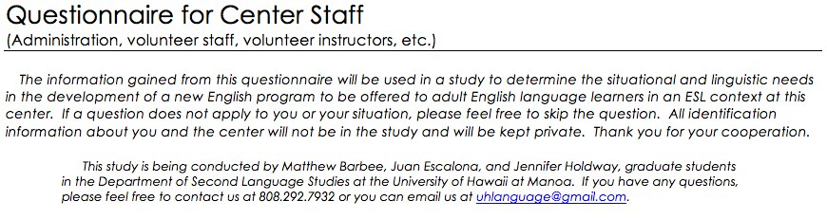
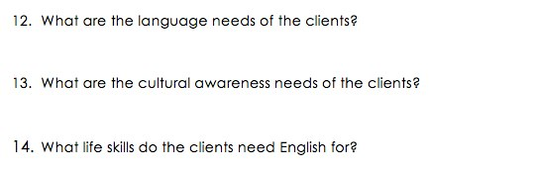
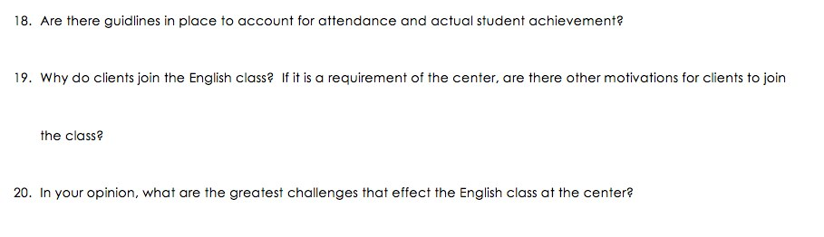
Situation Analysis: Staff and Teacher Questionnaire

Slide 23
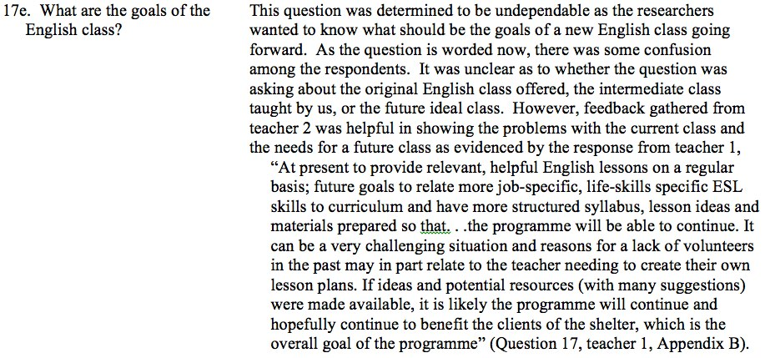
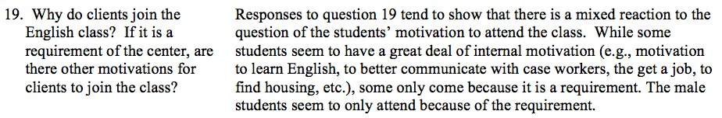
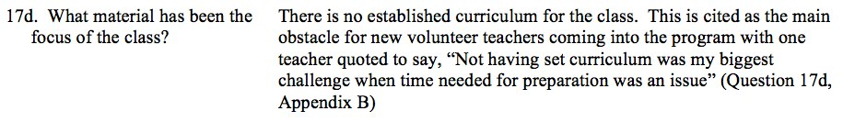
Situation Analysis: Staff and Teacher Questionnaire Responses

Slide 24
Learner Needs Analysis Results: Objective

Slide 25
Learner Needs Analysis Results: Objective

Slide 26
Learner Needs Analysis Results: Subjective
Observations
3 researchers = 3 roles in the classroom
Two major observations:
Lower literacy skills in four clients (later reduced to one)
Some students better at writing than producing
Students requested further assistance in spelling and vocabulary

Slide 27
Learner Needs Analysis Results: Subjective
Student
Questionnaires
Three questions
Responses
Students want to learn English to communicate better with doctors, case managers, etc.
Students want to live in Hawaii for better economic standing
Students plan on staying in Hawaii indefinitely
Do you like learning English? Why?
Do you like living in Hawaii? Why?
How long do you plan on staying in Hawaii?

Slide 28
Learner Needs Analysis Results: Subjective
Lesson plan
Students wrote about:
Narratives
Previous experience with English learning
Reasons for learning English
Problems faced not fully understanding English
Motivation to learn English
Very limited exposure
One student with English certificate
To get a job
To speak without interpreters (e.g. to doctors, case managers, etc.)
At the store
At a job interview
They showed appreciation towards teachers
Intrinsic motivation (for their own benefit)

Slide 30
Needs Analysis: Discussion of Results
S/T/St: Language skills for mainly employment and housing
St: case manager, without interpreter
Challenges to meet
  Attendance (mandatory/late)
  Childcare
  Self-confidence/motivation
  Language levels
  Resources

Slide 31
• Objectives and Syllabus
• Materials
• Teacher’s Guide
Program Development

Slide 32
Objectives and Syllabus
Program Development

Slide 33
Objectives and Syllabus
Functional Syllabus
  Based on functions of language as they best fit the students’ needs (e.g. requesting information on job posting)
Situational Syllabus
  Language in different contexts
  Based on specific situations (e.g. at the doctor’s office)

Slide 34
Functional & Situational Categories
Greetings and Introductions
Forms and Documents
Personal Information
Directions
Events and Scheduling
Shopping
Phone Calls
Jobs
Job Interviews
Medical Needs
Computer Literacy Skills
Setting up an Email Account

Slide 35
Sample Objectives

Slide 36
Materials
Program Development

Slide 37


All-Star Book 1
CHAPTER TITLES
Meeting Your Classmates
Getting Started
Time and Money
Calendars
Health
Work
Strengths
  Topics for survival English
  Images: source for discussion; make real-life connections (see to prior knowledge)
  Access to textbook and workbook
Limitations
  Names and places were unfamiliar to the clients from Micronesia
Notes:
“Simon Cowell and Naomi Campbell _________ from England.”
Getting Started (such as exchanging personal information; saying and understanding numbers (telephone, area code, zip code); using appropriate greetings and partings; asking about occupations; and, introducing people); Time and Money (read a time schedule; ask for and tell the time of day), Calendars (talk about appointments; make, cancel, and reschedule an appointment), Health (talking about health problems), and Work (responding to job ads; completing job applications).

Slide 38


Downtown 1: English for Work and Life
CHAPTER TITLES
Personal Information
Shopping
Time
Busy Lives
The Community
Housing
Health and Safety
Food
Work
Strengths
  Topics for survival English
  Activities complement the chapters well
  Access to textbook and workbook
Limitations
  Directed to Spanish speaking audiences (Character names)
  Some activities may focus too much on grammar
Notes:
Personal Information, Shopping, Time, Busy Lives, The Community, Housing, Health and Safety, Food, and Work

Slide 39
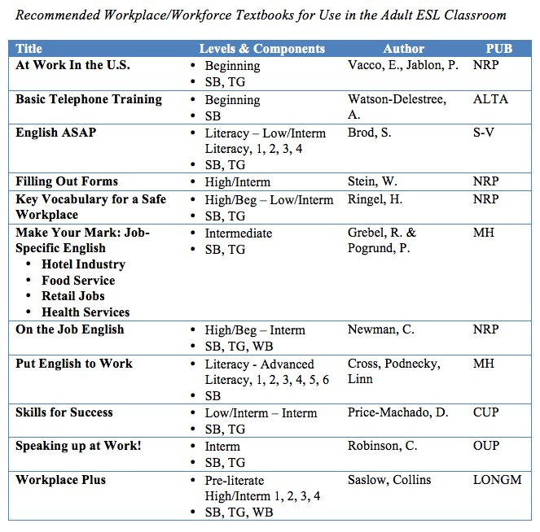
Other textbooks for adult ESP learners:
Workplace/Workforce English

Slide 40
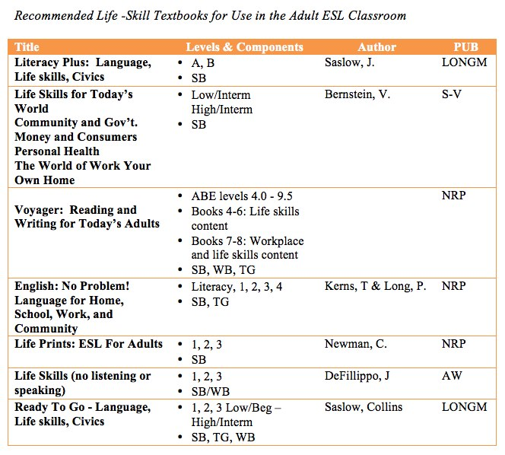
Other textbooks for adult ESP learners:
Workplace/Workforce English

Slide 41
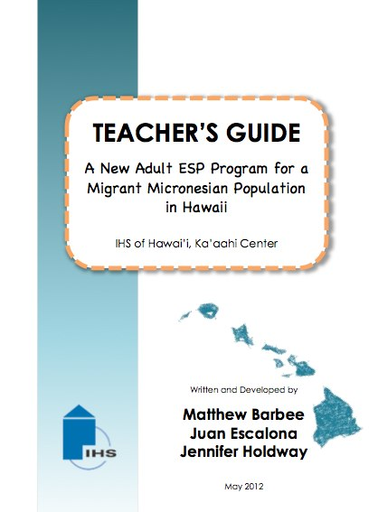
Teacher’s Guide
Program Development

Slide 42

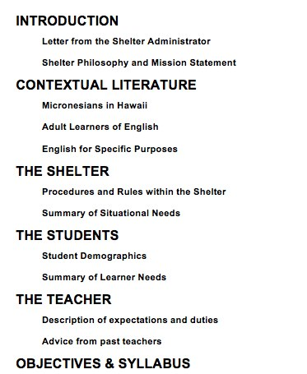
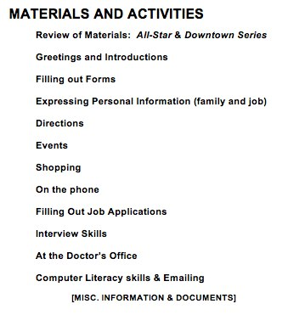
Teacher’s Guide: Table of Contents

Slide 43
Final Thoughts
Program Development

Slide 44
NEED FOR VOLUNTEERS!
The future of this program is dependent on skilled volunteers, like you, to serve as teachers. Please contact us or Barbara Cooney in the SLS Department for more information on how you can help.
www.ihshawaii.org

Slide 45

References
Belcher, D. (2006). Teaching to Perceived Needs and Imagined Futures in Worlds, Study, and Everyday Life. TESOL Quarterly, 40(1), 133-156.
Brown, J. D. (1995). The elements of language curriculum: A systematic approach to program development. Boston, MA: Heinle & Heinle Publishers.
Brown, J. D. (2001). Using surveys in language programs. Cambridge, England: Cambridge University Press.
Celce-Murcia, M. (2007). Rethinking the role of communicative competence in language teaching. In E. A. Soler, & M. P. S. Jorda (Eds.), Intercultural language use and language learning (pp. 41-57). Dordrecht: Springer.
Denzin, N. K. (1994). The art and politics of interpretation. In N. K. Denzin & Y. S. Lincoln (Eds.), Handbook of qualitative research (pp. 500-515). Thousand Oaks, CA:Sage.
Frye, D. (1999). Participatory Education as a Critical Framework for an Immigrant Women’s ESL Class. TESOL Quarterly, 33(3), 501-513.
Grieco, E. M. (2003). The Federated States of Micronesia: The "Push" to Migrate. The Migration Policy Institute. Retrieved from http://www.migrationinformation.org/Feature/display.cfm?ID=143
Hezel, F. X, & Samuel, E. (2006, November 10). Micronesians abroad. The Micronesian Counselor, 64. Retrieved from http://www.micsem.org/pubs/counselor/pdf/mc64.pdf
Hyon, S. (1996). Genre in three traditions: Implications for ESL. TESOL Quarterly, 30(4), 693-722.
Kaur, S. (2007). ESP course design: Matching learner needs to aims. English for Specific Purposes, 6(1).
LaFrance, A. (2009, February 25). Legal Aliens: The new face of immigration. Honolulu Weekly. Retrieved from http://honoluluweekly.com/cover/2009/02/legal-aliens/
Lee, L., Tanaka, G., & Velasco, S. (2011). All-Star, second edition. McGraw-Hill: New York.
Migrant Policy Institute. (2003). Migration facts, stats, and maps: Hawaii social and demographic characteristics. Retrieved from http://www.migrationinformation.org/datahub/state.cfm?ID=HI

Slide 46
Miller, J. C. (2004). Recommended textbooks for use in the adult ESL classroom. Retrieved from http://www.cde.state.co.us/pdf/ESLTextRecs1105Rev.pdf
National Center for Education Statistics. (2004). Participation of adults in English as a second language classes: 1994–1995. Washington, DC: Author. Retrieved from http://nces.ed.gov/pubs97/web/97319t.asp
Nunan, D. (1988). The learner centered curriculum. Cambridge: CUP
Nunan, D. (1990). Using learner data in curriculum development. ESP Journal, 9, 17-32.
Omori, J., Kleinschmidt, C., Lee, E., Linshield, T., Kuribayashi, T., & D. Lee. (2007). Reasons for Homelessness among Micronesians at a Transitional Shelter in Hawai’i. Developing Human Resources in the Pacific, 14(1), 212-217.
Pobutsky, A., Buenconsejo-Lum, L., Chow, C., Palafox, N. & G. Maskarinec. (2005). Micronesian Migrants in Hawaii: Health Issues and Culturally Appropriate, Community-Based Solutions. Californian Journal of Health Promotion, 3(4), 59-72. Retrieved from http://www2.hawaii.edu/~lbuencon/2005%20CJPH%20Micronesian%20Migrants%20in%20Hawaii.pdf
Richards, J. (2001). Curriculum development in language teaching. Cambridge: CUP.
Skilton-Sylvester, E., & Carlo, M. (1998). “I want to learn English”: Examining the goals and motivations of adult ESL students in three Philadelphia learning sites (Technical Report No. TR98-08). Philadelphia: National Center for Adult Literacy. Retrieved from http://literacyonline.org/products/ncal/pdf/TR9808.pdf
Status of Micronesian migrants: A study of the impact of the compacts of free association based of censuses of Micronesian migrants to Hawaii, Guam and the Commonwealth of the Northern Mariana Islands. (2003). U.S. Office of Insular Affairs. Retrieved from http://www.pacificweb.org
U.S. Census Bureau. (2010a). Profile of the foreign-born population in the United States. Washington, DC: Author. Retrieved from http://www.census.gov/prod/2002pubs/p23-206.pdf
U.S. Department of Education, Office of Vocational and Adult Education, Division of Adult Education and Literacy. (2004). State-administered adult education program enrollment: 2002- 2003. Washington, DC: Author.
FIN

Slide 47
From Needs Analysis to
Program Development
A New Adult ESP Program for a Migrant Micronesian Population in Hawaii
Matthew Barbee
Juan Escalona
Jennifer Holdway
QUESTIONS

