Slide 1
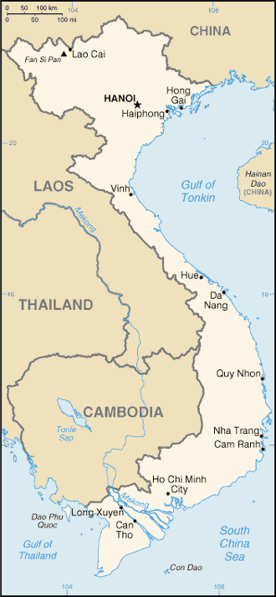
VIETNAMESE
tiếng việt
Notes:
Today, we will present an overview, if you will, of the language, Vietnamese, it’s background, some characteristics of its phonology, morphology, and syntax, with a few interesting facts along the way that may be new to some of you.
Vietnamese, the language, is pronounced….

Slide 2
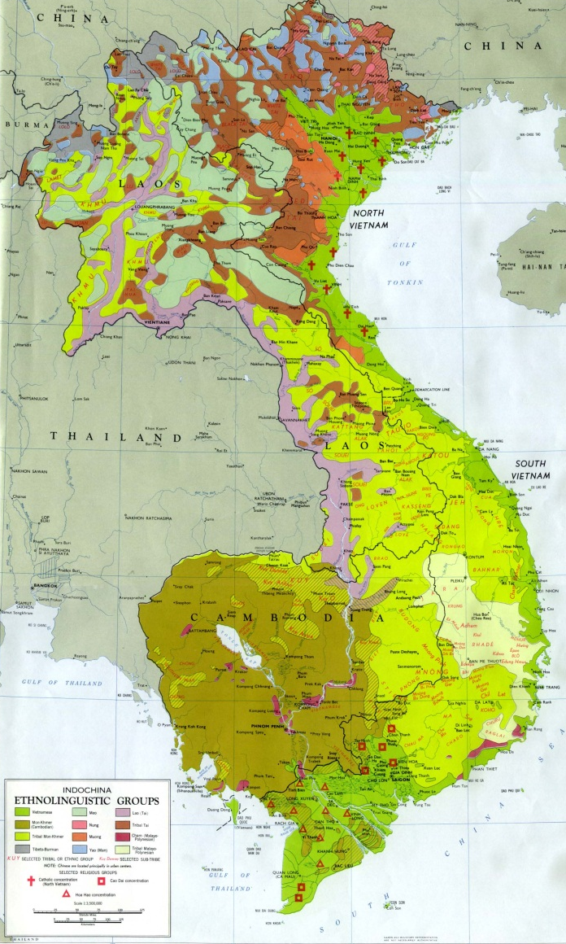
The Language vs. The Country
There are 103 languages spoken in Vietnam.
For 20% of the Vietnamese people, Vietnamese is their second language.
3 millions overseas speakers of Vietnamese (1/3 of those in America).
Vietnamese is the 7th most spoken language in the world.
Notes:
Because, according to ethnologue, there are 103 distinct languages within Vietnam itself and only 80% of the Vietnamese people speak Vietnamese as their first language, we would first like to make a distinction between the country and the language itself.
Also, there are 3 million Vietnamese speakers living overseas.
And interestingly enough, Vietnamese is the 7th most spoken language in the world. [6th in Hawaii, 3th in Texas]

Slide 3
Overview of the Language
Vietnamese is part of the Austro-Asiatic language family.
Heavily influenced by it history with China and France.
Chinese was the official spoken and written language in Vietnam just under 400 years ago. → VOCABULARY
As a byproduct of French-colonial rule, many examples of French influence can be found in the language. → VOCABULARY
The present writing system:
Written with the Latin alphabet
The 26 letters of the English alphabet minus f, j, w, and z.
Seven modified letters using diacritics: ᵭ, ă, ȃ, ȇ, ȏ, ȍ, and ȕ
Developed by Portuguese Jesuit missionaries in the 17th century.

Slide 4
Phonetics/Phonology
VIETNAMESE

Slide 5
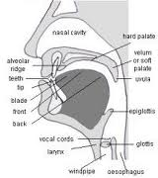
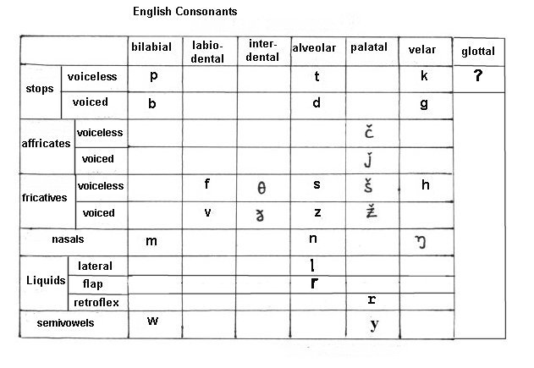
Phonology / Phonetics
A study of sounds in a language
Vowels & Consonants
21 initial consonants &
8 final consonants

Slide 6
Restriction on final sounds
Only a limited number of sounds can be
final consonants in Vietnamese
→ 6 consonants & 2 glides. (/w/, /j/ )
 | Bilabial | Alveolar | Velar
Stop(without aspiration) | p̚ | t̚ | k̚
Nasal | m | n | ŋ
Case
Pencil
What words are you hearing?

Slide 7
8 final consonants
/m/ e.g) em [em] (younger sister/brother)
/n/ e.g) phiên [fien] (turn)
/p ̚/ e.g) úp [up̚] (up-side-down), tiêp [tiep ̚] (continue)
/t ̚/ e.g) giêt [iet ̚] (kill), ghêt [gεt ̚] (hate)
/k ̚ /, /ŋ/
Allophones :
Allophones are segments that are phonetically distinct
but phonologically the same. To define as allophones of
one morpheme, they should be distributed
complementarily, that is each of them never occurs in
the same environment.

Slide 8
/k̚/
1)/ k̚/ → [ k̚ + p̚] (bilabialised)
/ [-consonantal, +round] _____
e.g.,) côc [kok̚ + p̚] (glass, cup)
nhuc [Jok̚ + p̚] (insulted)
2)/ k̚/ → [c̚] (becomes a pre-velar sound,palatalization)
/ [ front vowels such as i, e, or ε ] _____
e.g.,) lêch [lic̚] (askew)
sâch [sεc̚] (book)
3)/ k̚/ → [ k̚]/elsewhere
e.g.,) nhâc [Jak̚] (lazy)
búc [bʌk̚] (angry)

Slide 9
/ŋ/
1)/ŋ/ → [ŋ+m] (bilabialised)
/ [-consonantal, +round] _______
e.g.,) Xong [soŋ+m] (finish), sung [suŋ+m] (gun)
2)/ŋ/ → [ŋn] (becomes a pre-velar sound)
/ [ front vowels such as i, e, and ε ] ______
e.g.,) benh [beŋn] (sick)
tinh [tiŋn] (love)
3)/ŋ/ → [ŋ] / elsewhere
e.g.,) tâng [tâŋ] (give)

Slide 10
2 Semi-vowels (Glides)
/w/: it appears in forms of letters “u” or “o”
which allow vowels to make diphthongs or
triphthongs.
→ dau [daw] (hurt), vào [vaw] (enter)
/j/: it appears in forms of “I” or “y” and is
preceded by vowels to make diphthongs or
triphthongs.
→ tay [taj] (hand)

Slide 11
Interesting Point
The difference in word-final sound in Vietnamese and English prevents Vietnamese students from pronouncing some English words correctly.
L1 interference: when a person’s knowledge of their native language affects, interferes with, or impedes the use or acquisition of their second language.

Slide 12
Morphology
VIETNAMESE

Slide 13
What kind of language is Vietnamese?
Isolating/Analytic: low morpheme-per-word ratio
Vietnamese does not have morphological markings for:
case
gender
number
tense
…which means Vietnamese has no bound inflectional morphology.
As seen in many languages in Southeast Asia

Slide 14
Vocabulary
Much of the Vietnamese vocabulary is borrowed from Chinese (60% with Chinese roots not including Sino-Vietnamese words)
As a result of colonial rule, there is also influence from French in borrowed words such as:
cake – ga to
cheese – pho mat
zipper – phẹc mỏ tua

Slide 15
Morphemes and Syllables
Most Vietnamese morphemes consist of only one syllable i.e. cơm “cooked rice”, but there are words with more than just one i.e. dưa chuột “cucumber.”
Polymorphemic words are either compounds of words consisting of stems, affixes, or reduplicates.
Vietnamese is NOT a “monosyllabic” language – 80% is disyllabic due to derivation, and polysyllabic morphemes tend to be borrowings from other languages.

Slide 16
Word Formation
Reduplication
increases/decreases intensity
literary device
Examples of reduplication increasing intensity:
lắm → lắm lắm: very → very much
ầm → ầm ầm: noisy → rumble, roar
Examples of reduplication decreasing intensity:
nhẹ → nhè nhẹ: soft → less soft
xinh → xinh xinh: pretty → cute

Slide 17
Word Formation
Compounding
máy bay ăn uống machine fly eat drink N + V V + V
‘airplane’ ‘eat and drink’
xe đạp hòa thuận vehicle pedal peaceful agree
N + V A + A
‘bicycle ‘to be in accord’

Slide 18
Word Formation
Affixation - limited with prefixes and suffixes
-gia (家) “profession”
chính trị gia “politician”
khoa học gia “scientist”
phi- (不)“not”
phi nghĩa “unethical” phi chính phủ “non-governmental”

Slide 19
SYNTAX
VIETNAMESE

Slide 20
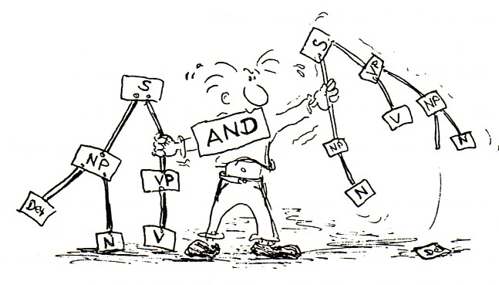
Basic Syntactic Features
SVO
Head-initial

Slide 21
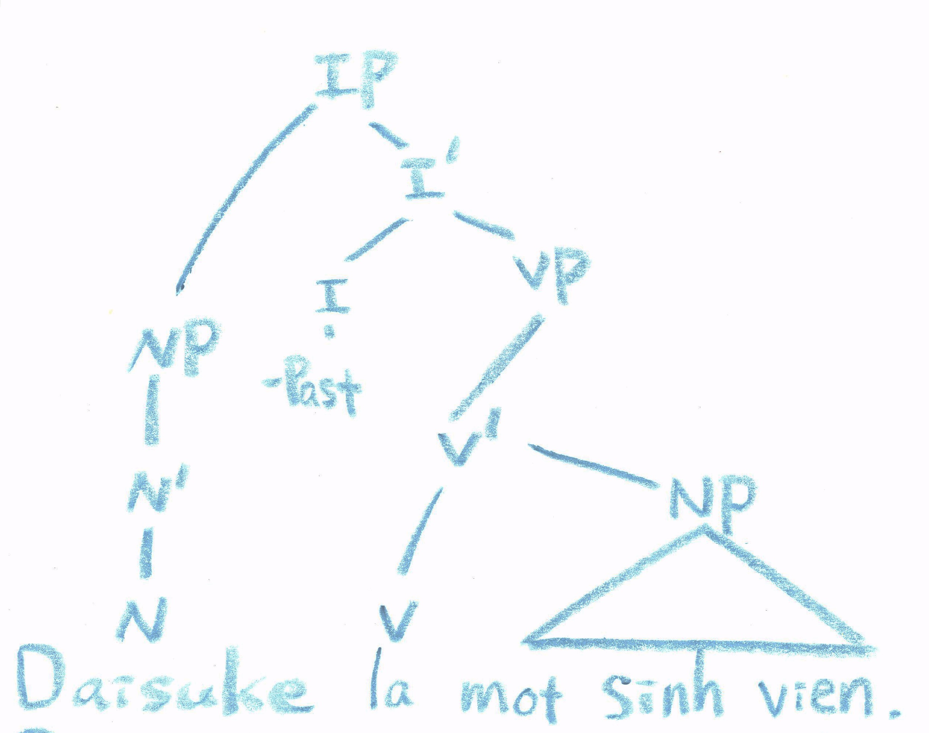
Daisuke is a student. Daisuke la mot sinh vien.
Daisuke is a student

Slide 22
Is Daisuke a student? Daisuke là một sinh viên?
?
?
Daisuke is a student

Slide 23
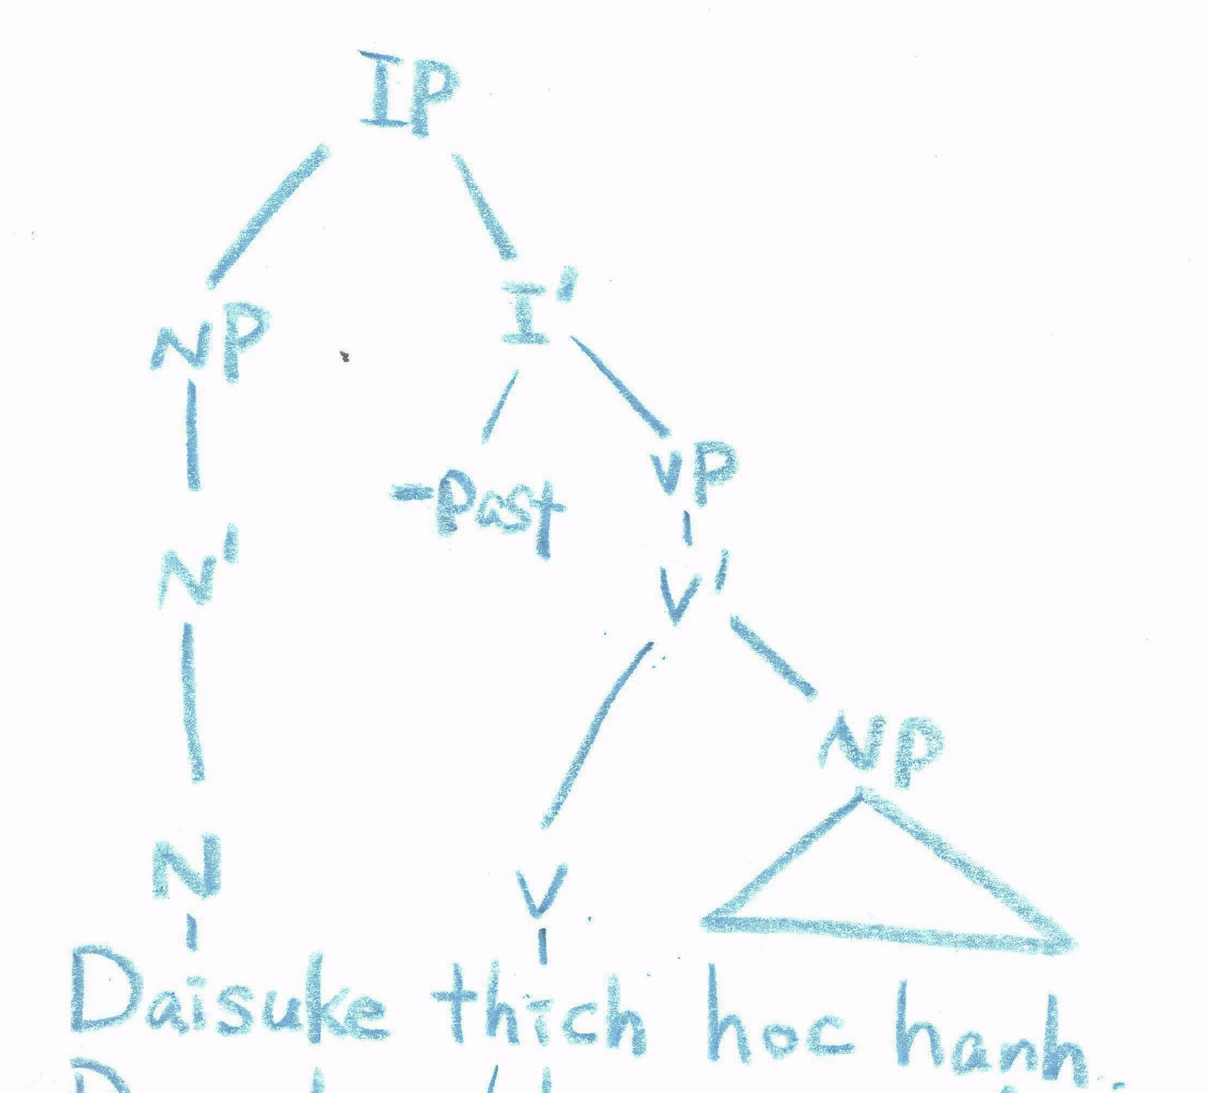
Daisuke likes studying. Daisuke thich hoc hanh.
Daisuke like study

Slide 24
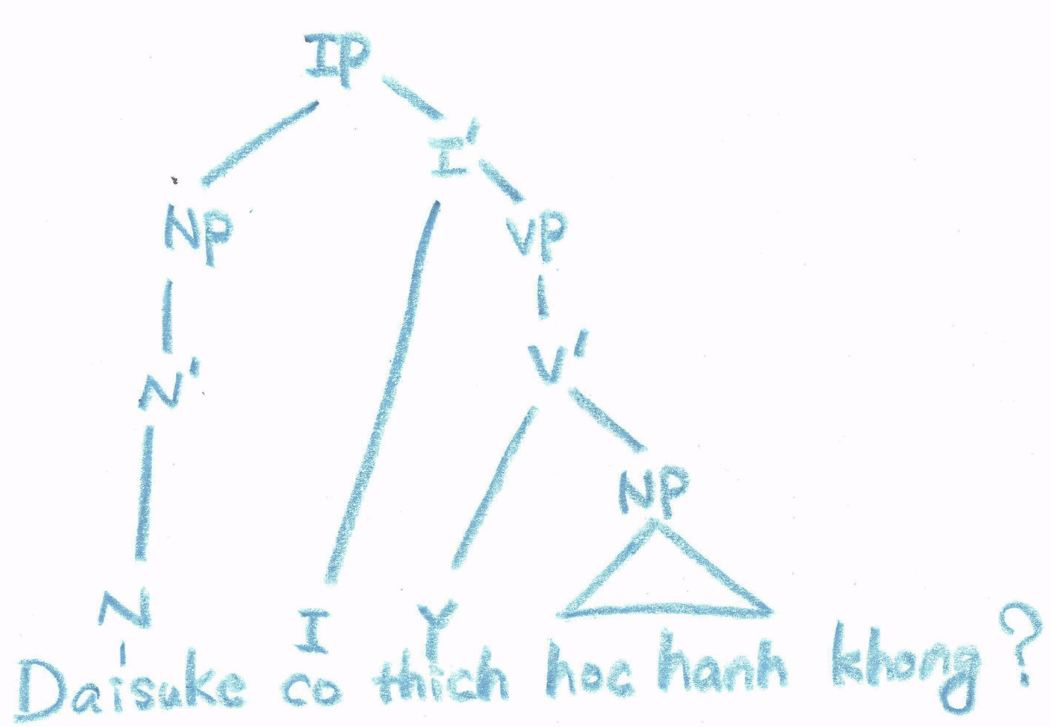
Does Daisuke like studying? Daisuke co thich hoc hanh khong?
Daisuke have like study no

Slide 25
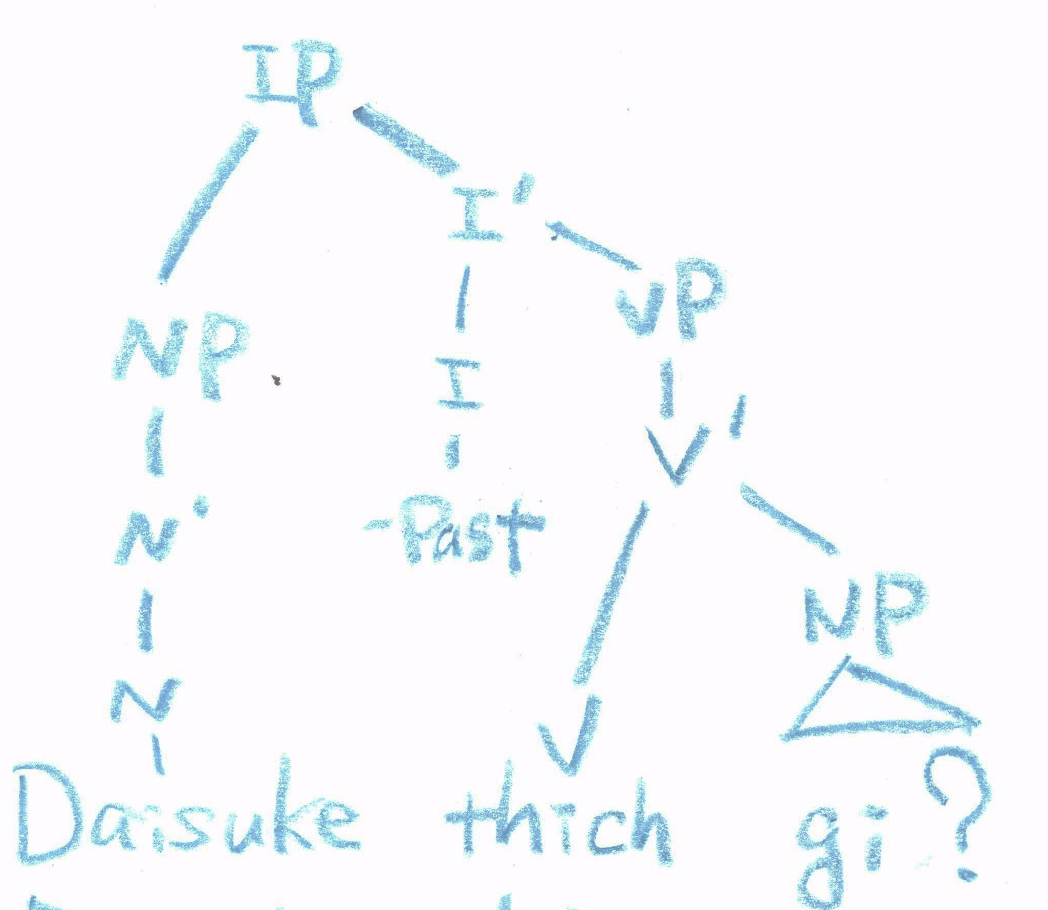
What does Daisuke like? Daisuke thich gi?
Daisuke like what

Slide 26
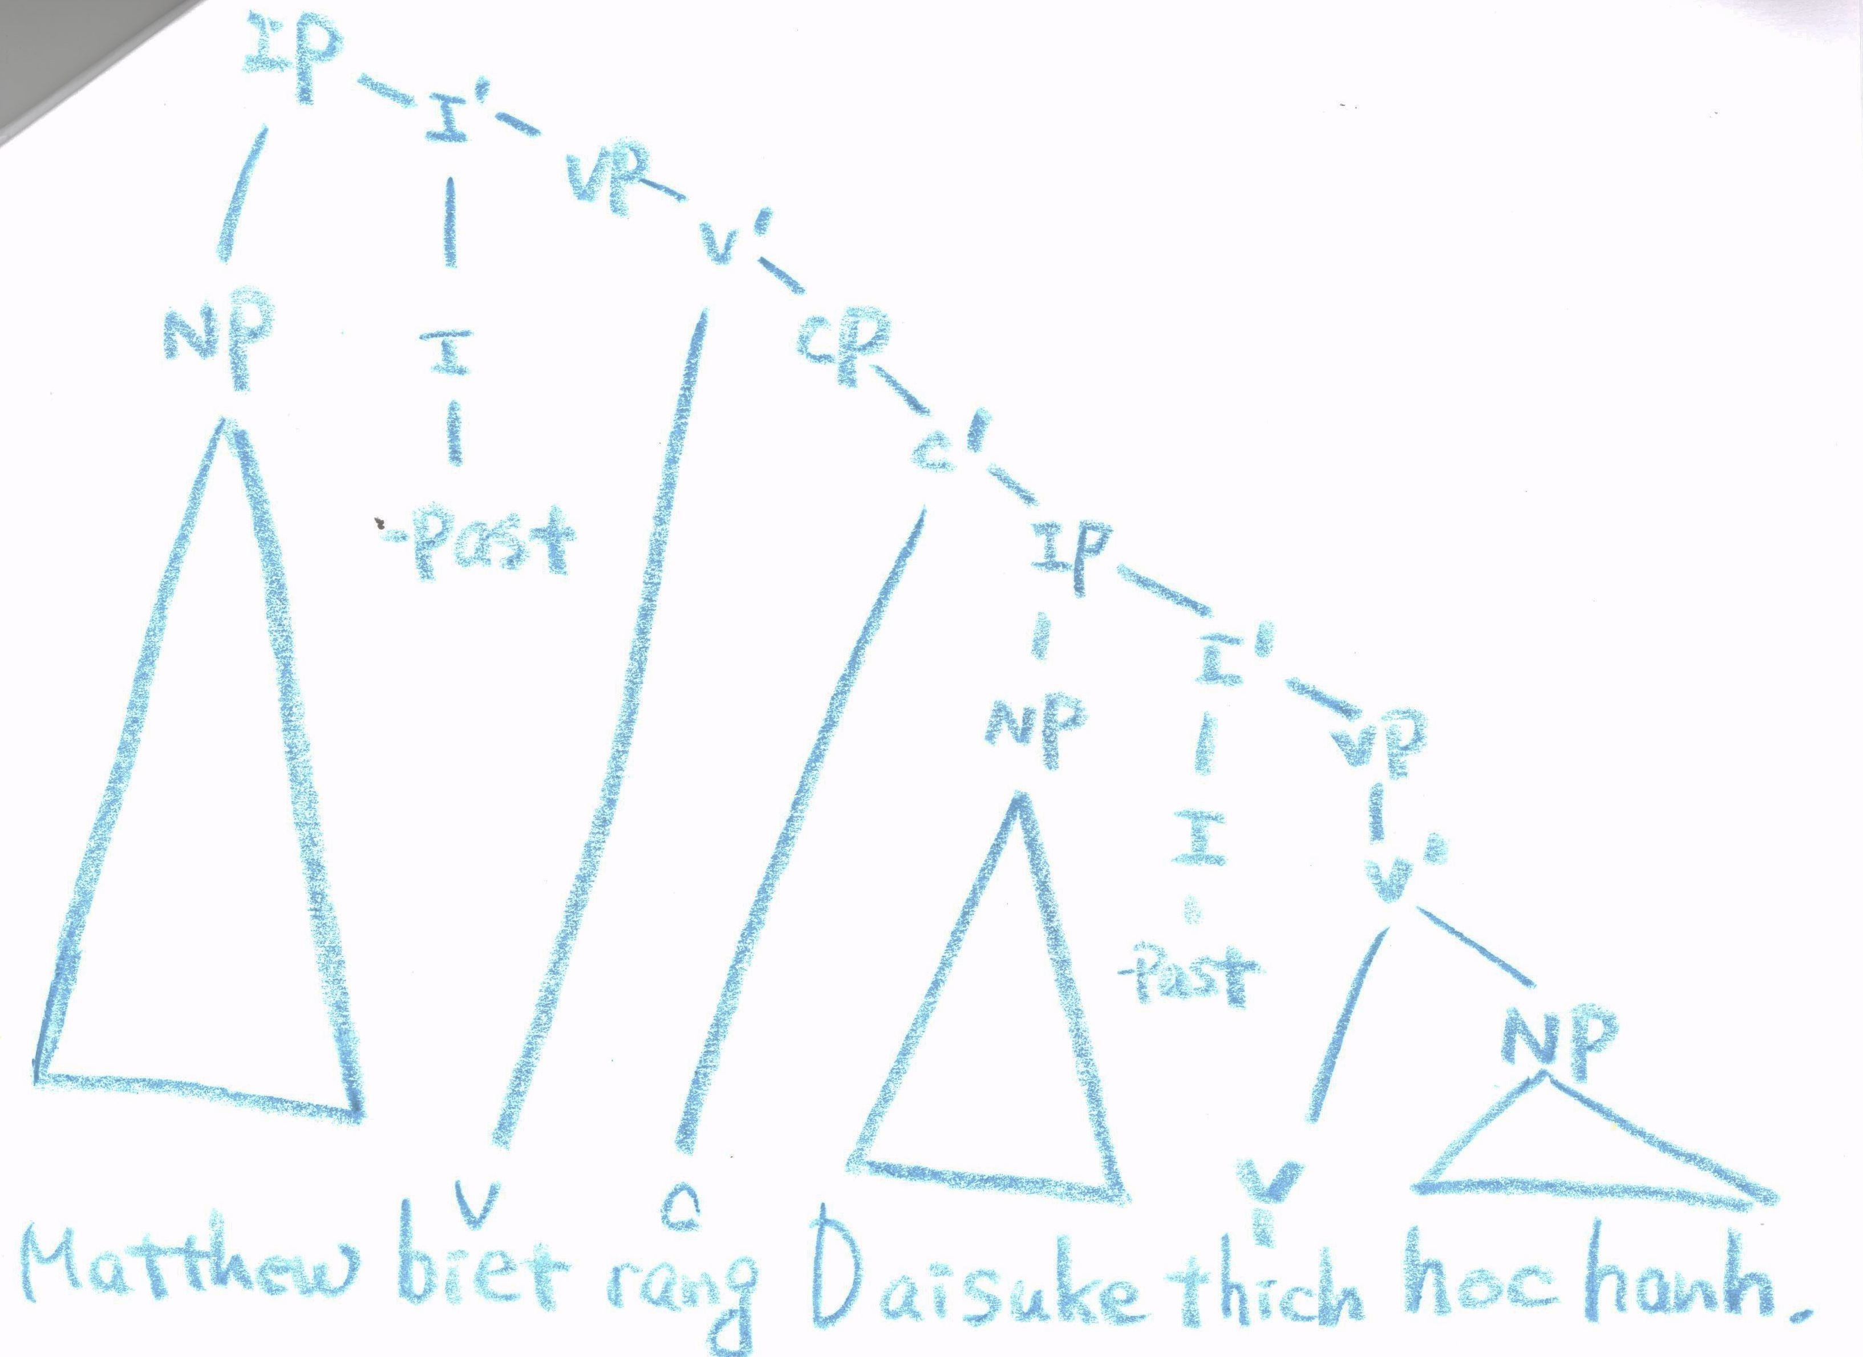
Matthew knows that Daisuke likes studying. Matthew biet rang Daisuke thich hoc hanh.
Matthew know that Daisuke like study

Slide 27
Interesting Point
No Wh- or I to C movements
e.g., What does Daisuke like? Daisuke say me gi?
Does Daisuke like studying? Daisuke co thich hoc hanh khong?

Slide 28
Interesting Point
Four ways of constructing question sentences
Is Daisuke a student?
1. Daisuke la mot sinh vien? (written)
2. Daisuke la mot sinh vien, phai khong?
3. Co phai, Daisuke la mot sinh vien khong?
4. Daisuke co phai la sinh vien khong?

Slide 29
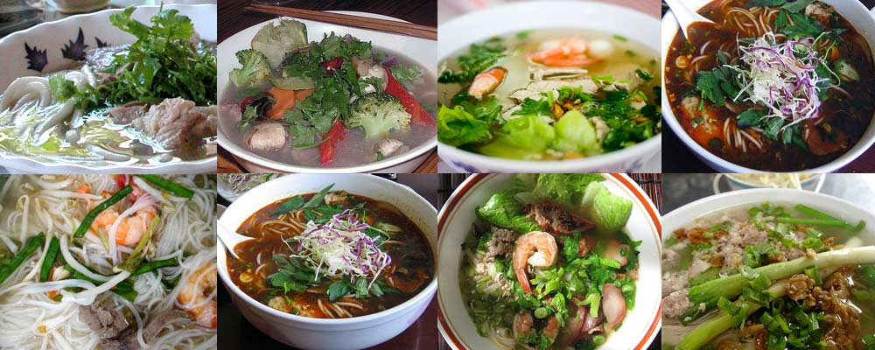
Conclusion
PHO

Slide 30
Thank you for listening.
Have a good day!

